Slide 1
Bioinformatics Lecture 3
“Phylogenetic Analysis”
Course code : MDS 657
25th August 2024
Roji Raut

Slide 2
Introduction
A phylogenetic tree (evolutionary tree) is the graphical representation of the evolutionary history of biological sequences and allows us to visualize the evolutionary relationships between them.
Evolution explains the diversity of life on Earth, and understanding evolutionary relationships helps us understand the origin and relationships between different organisms. Molecular phylogenetics is an important aspect of bioinformatics that helps us understand evolutionary history and relationships by using molecular data such as DNA or protein sequences to create phylogenetic trees.

Slide 3
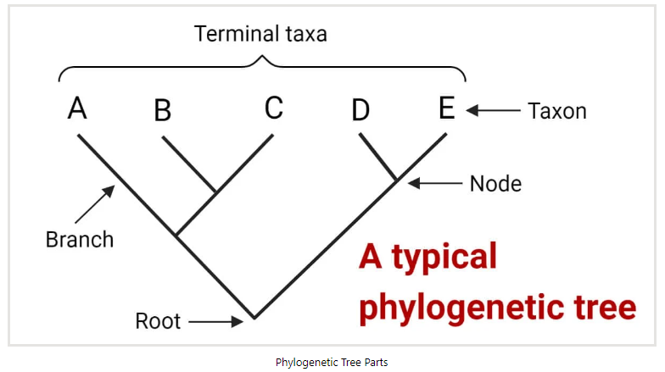
These trees are displayed as two-dimensional diagrams, with branching lines representing the evolutionary history and relatedness of different groups of organisms. The endpoints of the branches represent present-day species or sequences and are referred to as taxa or operational taxonomic units (OTUs). The connecting point where two branches come together is called a node, and it represents an inferred common ancestor of the organisms or sequences connected to the branches. The point where the tree divides into two parts at the bottom is known as the root node, and it represents the common ancestor of all the members of the tree.

Slide 4
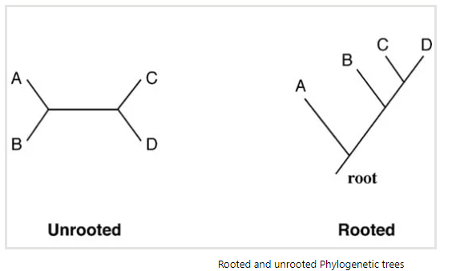
Types of Phylogenetic tree
A. On the basis of the presence or absence of a common root
Rooted trees are trees that have a specified root node, which represents the common ancestor of all the organisms in the tree.
Unrooted trees do not have a specified root node and show only the branching pattern of the evolutionary relationships among taxa or OTUs, without any information about their common ancestor.

Slide 5
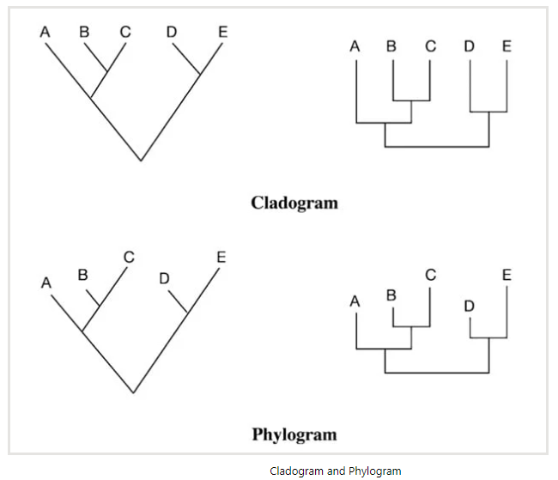
Types of Phylogenetic tree
B. On the basis of topology
Cladogram is a type of phylogenetic tree that displays only the branching pattern of evolutionary relationships among organisms. Cladograms are unscaled, which means that the branch lengths do not reflect the amount of evolutionary divergence between taxa or operational taxonomic units (OTUs).
Phylogram is a type of phylogenetic tree that represents the evolutionary relationships among organisms by showing both the branching pattern and the amount of evolutionary divergence. Phylograms are scaled, which means that the branch lengths are proportional to the amount of evolutionary divergence.

Slide 6
Types of Phylogenetic tree
Phylogram
Phylogram represents the cladistic relations and the absolute time scale of the divergence of the taxa.
In a phylogram, the branch lengths represent the amount of evolutionary divergence. Such trees are said to be scaled.
The scaled trees have the advantage of showing both the evolutionary relationships and information about the relative divergence time of the branches.

Slide 7
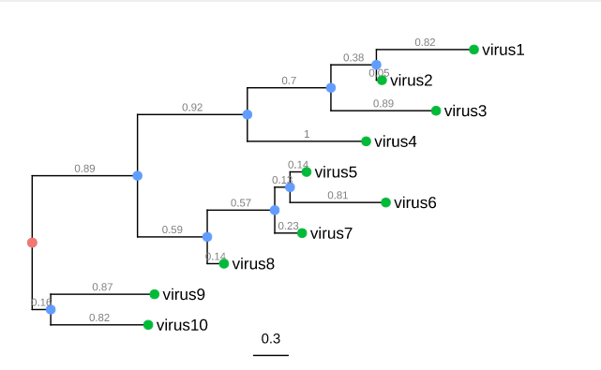
Types of Phylogenetic tree
Phylogram
The green circle, the external notes, represents the actual organisms sampled and sequenced, and are referred as taxa.
The blue circles, internal nodes, represents the hypothetical ancestors for the tips.
The red circle represents the common ancestor of all the species in the tree.
The horizontal lines are branches and represent evolutionary changes, and are measured in units of time or genetic divergence.
The bar at the bottom provides the scale of these branch lengths.

Slide 8
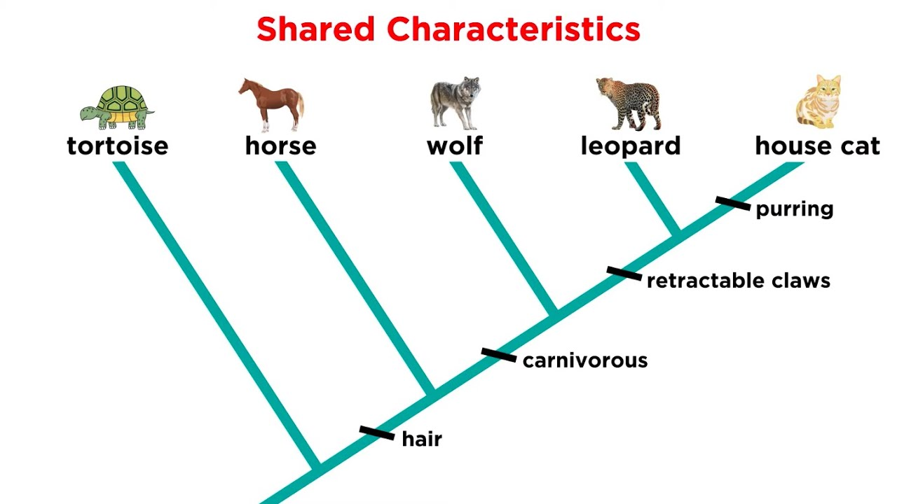
Types of Phylogenetic tree
Cladogram
A tree diagram representing the order of divergence of the groups, but no time scale of the process. It is based on cladistic properties.
A cladogram is not, however, an evolutionary tree because it does not show how ancestors are related to descendants.
A cladogram uses lines that branch off in different directions ending at a clade, a group of organisms with a last common ancestor.
In a cladogram, the external taxa line up neatly in a row or column. Their branch lengths are not proportional to the number of evolutionary changes and thus have no phylogenetic meaning.
In such an unscaled tree, only the topology of the tree matters, which shows the relative ordering of the taxa.

Slide 9
Types of Phylogenetic tree
Dendrogram:
A dendrogram is a general name for a tree, whether phylogenetic or not, and hence also for the diagrammatic representation of a phylogenetic tree.
Newick format
To provide information of tree topology to computer programs without having to draw the tree itself, a special text format known as the Newick format is developed.
In this format, trees are represented by taxa included in nested parentheses.
In this linear representation, each internal node is represented by a pair of parentheses that enclose all member of a monophyletic group separated by a comma.
For a tree with scaled branch lengths, the branch lengths in arbitrary units are placed immediately after the name of the taxon separated by a colon.

Slide 10
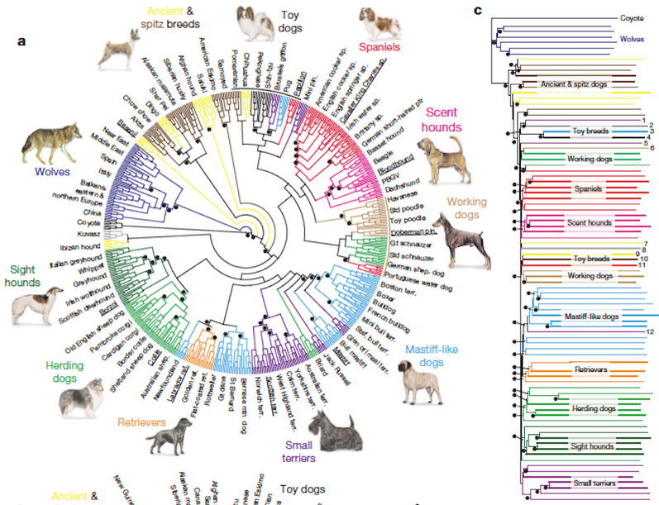
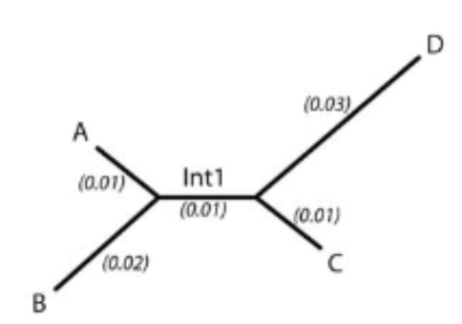

Slide 11
Tree Construction Methods
1. Distance-based methods
Distance-based tree construction methods involve calculating evolutionary distances between sequences by using substitution models, which are then used to construct a distance matrix. Using the distance matrix, a phylogenetic tree is constructed. The two popular distance-based methods are UPGMA and NJ.
2. Character-Based Methods
Character-based methods involve analyzing sequence data by directly examining the sequence characters, rather than relying on pairwise distance comparisons. These methods evaluate all sequences at once by analyzing one character or site at a time.
Character-based methods are generally considered more accurate than distance-based methods. However, character-based methods are more computationally intensive and require more sophisticated statistical models.
The maximum parsimony (MP) and maximum likelihood (ML) methods are the two most commonly used character-based tree construction methods.

Slide 12
Phylogenetic tree construction : Distance based methods
The algorithms for the distance-based tree-building method can be subdivided into either clustering based or optimality based.
The clustering-type algorithms compute a tree based on a distance matrix starting from the most similar sequence pairs.
These algorithms include an unweighted pair group method using arithmetic average (UPGMA) and neighbor joining.
The optimality-based algorithms compare many alternative tree topologies and select one that has the best fit between estimated distances in the tree and the actual evolutionary distances.

Slide 13
Distance based methods
a. Unweighted Pair Group Method with Arithmetic Mean (UPGMA)
UPGMA is the simplest distance-based method that constructs a rooted phylogenetic tree using sequential clustering.
First, all sequences are compared using pairwise alignment to calculate the distance matrix.
Using this matrix, the two sequences with the smallest pairwise distance are clustered as a single pair. A node is placed at the midpoint between them.
Next, the distance between this pair and all other sequences is recalculated to form a new matrix.
This new matrix is used to identify and cluster the sequence that is closest to the first pair. This process is repeated until all sequences have been placed on the tree.
UPGMA method assumes that the evolutionary rate of all taxa is constant, and they are equidistant from the root, indicating the presence of a molecular clock mechanism.

Slide 14
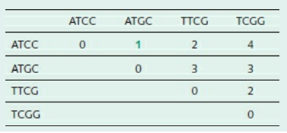
UPGMA
Unweighted Pair Group Method with Arithmetic mean
Consider four species characterized by homologous sequences ATCC, ATGC, TTCG, and TCGG.
Taking the number of differences as the measure of dissimilarity between each pair of species, use a simple clustering procedure to derive a phylogenetic tree.
The distance matrix is:

Slide 15

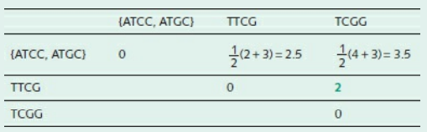
UPGMA
Because the matrix is symmetrical, we need fill in only the upper half.
The smallest distance is 1 (in green), between ATCC and ATGC.
Therefore, our first cluster is {ATCC, ATGC}.
The tree will contain the fragment:
The reduced distance matrix is:
The next cluster is {TTCG, TCGG}, distance 2.

Slide 16
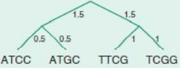
UPGMA
Phylogenetic tree construction : UPGMA
Finally, linking the clusters {ATCC, ATGC} and {TTCG, TCGG} gives the tree:
Branch lengths have been assigned according to the rule:

Slide 17
Distance based methods
b. Neighbor-Joining (NJ)
The neighbor-joining method is the most widely used distance-based method.
It is similar to the UPGMA method in terms of building the tree using a distance matrix however, it does not assume the molecular clock and produces an unrooted tree.
The neighbor-joining algorithm starts with a completely unresolved star tree, where all sequences are connected to a single node.
It then iteratively adds branches between the two closest neighbors and the remaining sequences in the tree. The algorithm calculates the pairwise distances between all sequences and uses these distances to determine the closest neighbors.
Once the closest neighbors are identified, the algorithm consolidates them into a new node, effectively reforming the star tree. This process is repeated until all sequences are connected in a fully resolved tree.

Slide 18
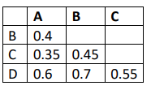

Phylogenetics
Phylogenetic tree construction : Neighbour joining method
The Neighbor Joining (NJ) method is similar to UPGMA, but uses an evolutionary rate correction step before tree building.
The first step of the NJ method is r-value and r’-value calculation.
The value of rA (or rB) is the sum of distances of A (or B) to all other taxa.
A generalized expression of the r-value is r_{i} calculated based on the following formula:
The r-values are needed to create a modified distance matrix.
The transformed r-values (r’ ) are used to determine the distances of an individual taxon to the nearest node.

Slide 19

Phylogenetics
Phylogenetic tree construction : Neighbour joining method
Assuming A and B form a node called U, the distance A to U is determined by the following formula:
The distance matrix of the four taxon

Slide 20
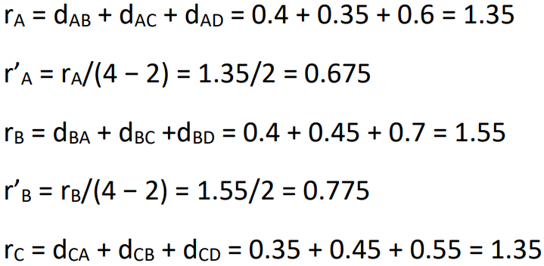
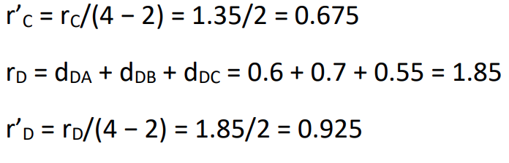
Phylogenetics
Phylogenetic tree construction : Neighbour joining method
The r and r’ for each taxon are calculated as follows:

Slide 21
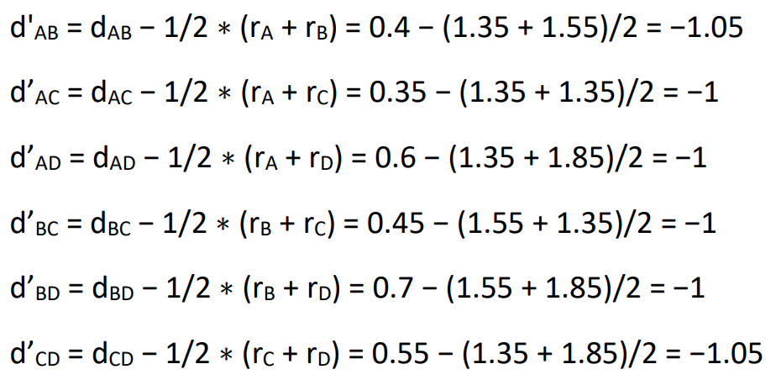
Phylogenetics
Phylogenetic tree construction : Neighbour joining method
The corrected distances are obtained as follows:

Slide 22
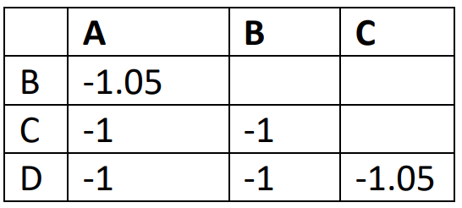
Phylogenetics
Phylogenetic tree construction : Neighbour joining method
The rate-corrected distances allow the construction of a new distance matrix

Slide 23
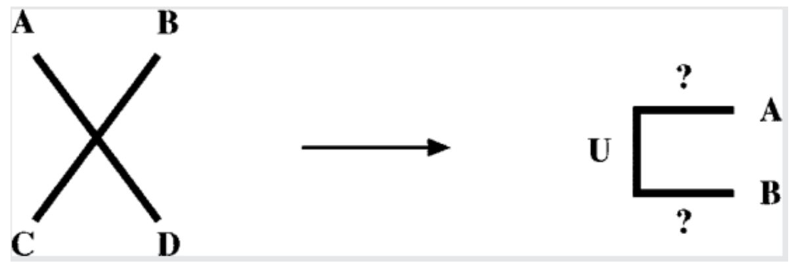
Phylogenetics
Phylogenetic tree construction : Neighbour joining method
Before the tree construction, all possible nodes are collapsed into a star tree.
The pair of taxa with the shortest distance in the new matrix is separated from the star tree first.
Therefore, the first node to be built can be either A-B or C-D.
Choosing either pair first will give us the same result.
Let’s choose A and B first, and name the node U.

Slide 24
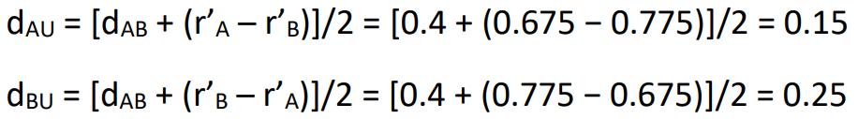
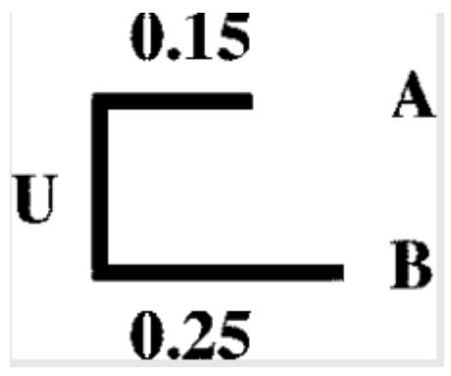
Phylogenetics
Phylogenetic tree construction : Neighbour joining method
The branch length from A and B to the node U is calculated as:

Slide 25
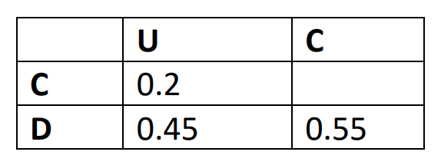
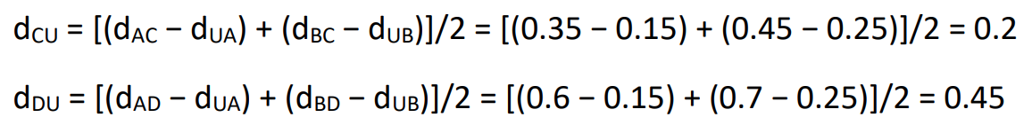
Phylogenetics
Phylogenetic tree construction : Neighbour joining method
The first cluster is formed, and now we again need to construct the reduced matrix.
This starts with the actual distances.
However, unlike UPGMA, the distance from a taxon to a node is average of the original distances to each of the components of the composite taxon subtracted from the inferred branch length.

Slide 26
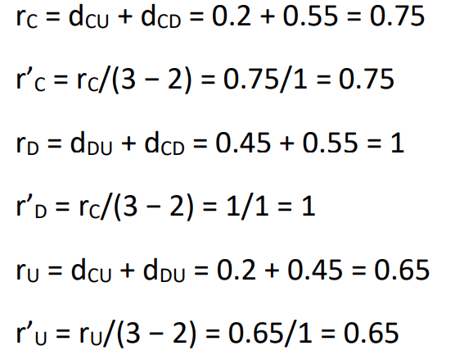
Phylogenetics
Phylogenetic tree construction : Neighbour joining method
Based on the new reduced distance matrix, a new set of r- and r’- values are calculated.

Slide 27
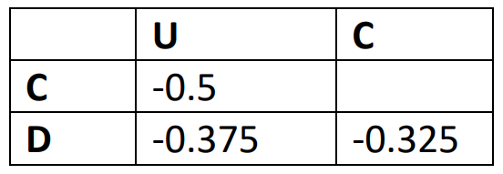
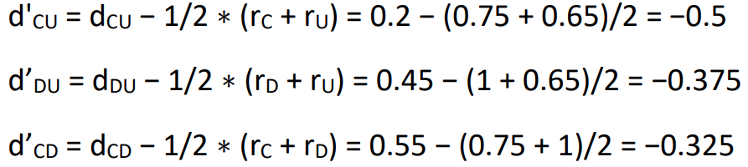
Phylogenetics
Phylogenetic tree construction : Neighbour joining method
The new r- and r’-values allows construction of the corrected distance matrix.

Slide 28
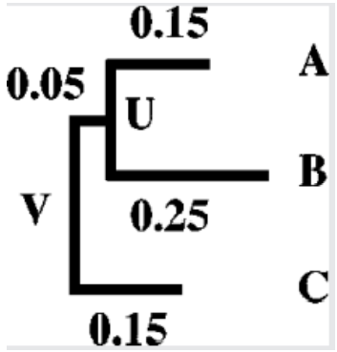
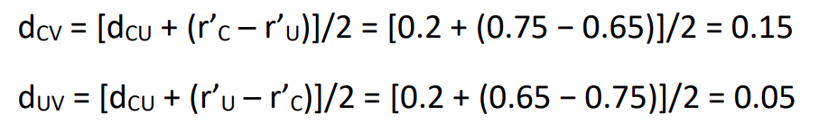
Phylogenetics
Phylogenetic tree construction : Neighbour joining method
In the corrected distance matrix, C to node U has the shortest distance.
This allows the creation of the second node named V.
The branch length is calculated

Slide 29
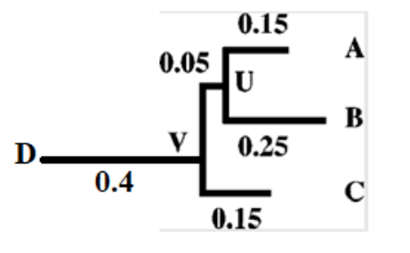
Phylogenetics
Phylogenetic tree construction : Neighbour joining method
Because D is the last branch to be decomposed from the star tree, there is no need to convert to r and r’ because r’ is infinitely large when n − 2 = 0.
Its branch length is calculated as one half of the sum of D to node V and D to C, subtracted from respective branch lengths.

Slide 30
Optimality based methods
The clustering-based methods produce a single tree as output.
However, there is no criterion in judging how this tree is compared to other alternative trees.
In contrast, optimality-based methods have a well-defined algorithm to compare all possible tree topologies and select a tree that best fits the actual evolutionary distance matrix.
Based on the differences in optimality criteria, there are two types of algorithms, Fitch–Margoliash and minimum evolution.
The exhaustive search for an optimal tree necessitates a slow computation, which is a clear drawback especially when the dataset is large.

Slide 31
Optimality based methods
Fitch-Margoliash
The Fitch–Margoliash (FM) method selects a best tree among all possible trees based on minimal deviation between the distances calculated in the overall branches in the tree and the distances in the original dataset.
It starts by randomly clustering two taxa in a node and creating three equations to describe the distances, and then solving the three algebraic equations for unknown branch lengths.
The clustering of the two taxa helps to create a newly reduced matrix.
This process is iterated until a tree is completely resolved.
The method searches for all tree topologies and selects the one that has the lowest squared deviation of actual distances and calculated tree branch lengths.

Slide 32
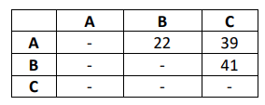
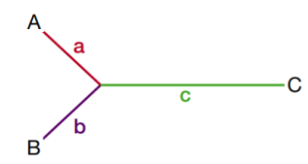

Phylogenetics
Phylogenetic tree construction : Fitch-Margoliash
On the basis of distance matrix given below, draw an unrooted tree with three branches emanating from a common node and label ends of the branches using Fitch-Margoliash algorithm.
We can use 3-point formula to calculate the branch length:

Slide 33
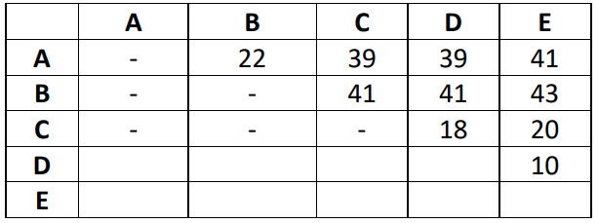
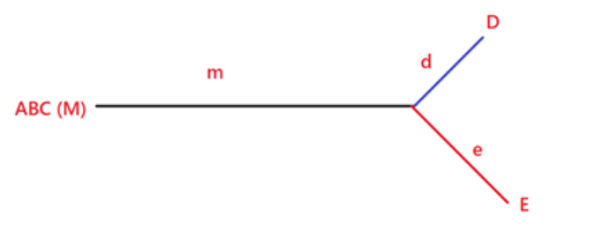
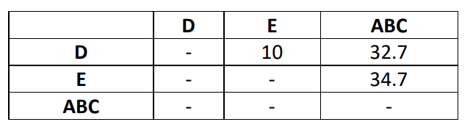
Phylogenetics
Phylogenetic tree construction : Fitch-Margoliash
The most closely related sequences from the above distance table are D and E. A new table is made with the remaining sequences combined.
The average distances from D to A, B, and C. And from E to A, B and C are calculated.

Slide 34

Phylogenetics
Phylogenetic tree construction : Fitch-Margoliash
The distance from D to ABC, and from E to ABC can be found by 3-point formula.
Now, D and E are treated as a single composite sequence (DE), and a new distance table is made.
The distance from A to (DE) is the average of the distance of A to D and A to E.
The other distance to (DE) are calculated accordingly.

Slide 35
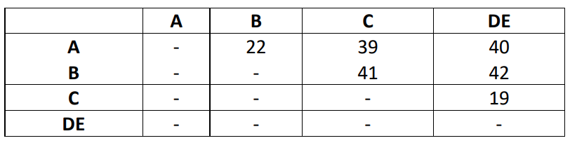
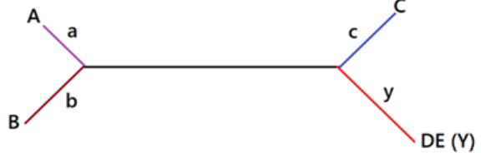
Phylogenetics
Phylogenetic tree construction : Fitch-Margoliash

Slide 36
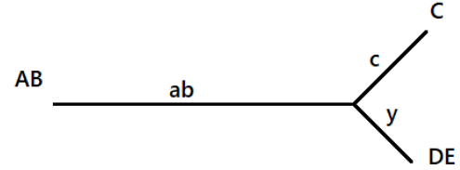
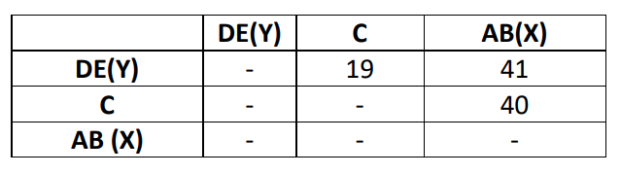
Phylogenetics
Phylogenetic tree construction : Fitch-Margoliash
The next most common sequences are known from the previous table.

Slide 37


Phylogenetics
Phylogenetic tree construction : Fitch-Margoliash

Slide 38
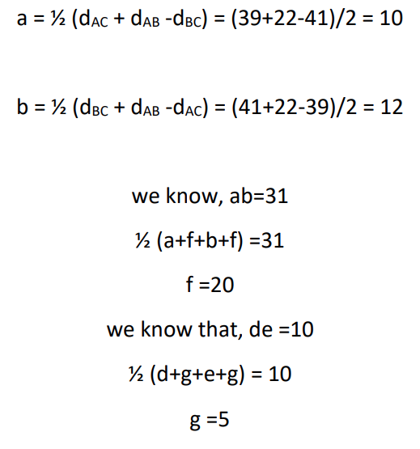
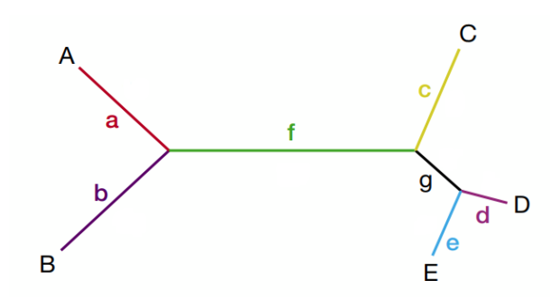
Phylogenetics
Phylogenetic tree construction : Fitch-Margoliash

Slide 39
Phylogenetics
Phylogenetic tree construction
Pros and Cons of distance based methods
The most frequently used distance methods are clustering based.
The major advantage is that they are computationally fast and are therefore capable of handling datasets that are deemed to be too large for any other phylogenetic method.
The methods, however, are not guaranteed to find the best tree.
Exhaustive tree-searching algorithms such as FM and ME have better accuracies overall. However, they can be computationally prohibitive to use when the number of taxa is large (e.g., >12), because the overall number of tree topologies becomes too large to handle.
A compromise between the two types of algorithm is a hybrid approach such as the generalized NJ, with a performance similar to that of ME but computationally much faster.
The overall advantage of all distance-based methods is the ability to make use of a large number of substitution models to correct distances.
The drawback is that the actual sequence information is lost when all the sequence variation is reduced to a single value. Hence, ancestral sequences at internal nodes cannot be inferred.

Slide 40
Phylogenetics
Phylogenetic tree construction : Character based method
Character-based methods (also called discrete methods) are based directly on the sequence characters rather than on pairwise distances.
They count mutational events accumulated on the sequences and may therefore avoid the loss of information when characters are converted to distances.
This preservation of character information means that evolutionary dynamics of each character can be studied.
Ancestral sequences can also be inferred.
The two most popular character-based approaches are the maximum parsimony (MP) and maximum likelihood (ML) methods.

Slide 41
Character based methods
a. Maximum parsimony (MP)
Maximum parsimony method is a character-based method that selects the tree with the least number of evolutionary changes or the shortest total branch length.
Initially, multiple sequence alignment is performed to identify potential positions in the sequences that correspond to each other.
Each aligned position is analyzed to identify the trees that require the smallest number of evolutionary changes to produce the observed sequence changes.
This process is repeated for all positions in the sequence alignment, and the trees that produce the lowest overall number of changes for all positions are selected.
This method works best for relatively similar sequences and for small numbers of sequences.

Slide 42
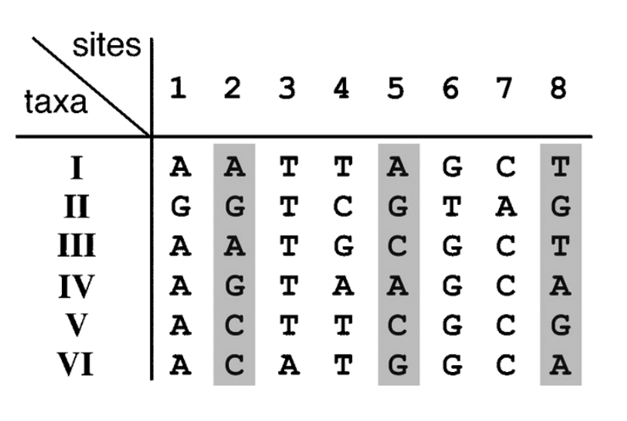
Phylogenetic tree construction : Maximum parsimony
Identification of informative sites that are used in parsimony analysis. Sites 2, 5, and 8 (grey boxes) are informative sites. They have at least two different kinds of characters, each occurring at least twice.
Other sites are noninformative sites, which are either constant or having characters occurring only once.

Slide 43

The principle of parsimony dictates that a theory should provide the simplest possible (viable) explanation for a phenomenon.

Slide 44
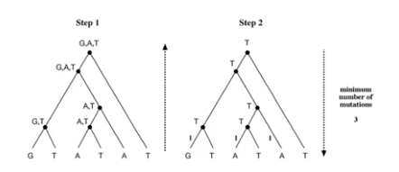
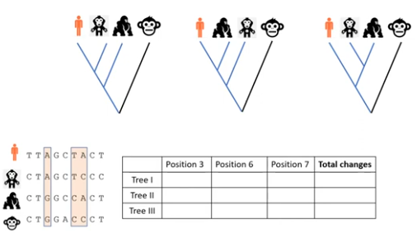
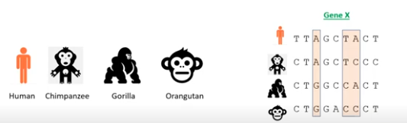
Maximum Parsimony
 | Position 3 | Position 6 | Position 7 | Total changes
Tree I | 1 | 1 | 2 | 4
Tree II | 2 | 2 | 1 | 5
Tree III | 1 | 2 | 2 | 5

Slide 45
Character based methods
B. Maximum likelihood (ML)
Maximum likelihood is a statistical method that uses probabilistic models to identify the most appropriate tree that has the maximum probability of generating the observed data.
Similar to the maximum parsimony method, this approach evaluates each column of a multiple sequence alignment during the analysis.
ML considers all possible trees that could explain the observed data.
The likelihood of each possible tree is calculated, and the tree with the highest probability is selected as the most likely evolutionary history of the sequences.

Slide 46
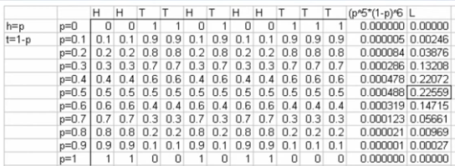
Coin flip example
HHTTHTHHTTT (1 independent tosses)
5 Heads (p)
6 tails
What is the likelihood of this series to occur>
L = (n!/((k!)(n-k)!) * p^{k} (1-p)^{n-k}
n = number of toses
K = number of heads observed
P = probability of heads
1-p = probability of tails
Since n and k are observed you can try various values for p to find one that maximizes L.

Slide 47
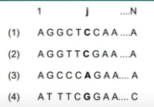
Maximum Likelihood
To calculate the likelihood for site j, we have to consider all the possible scenarios by which the nucleotides present at the tips of the tree could have evolved. So the likelihood for the full tree is th product of the likelihood at each site
L = L(1) x L(2) …….. X L(N)
ln L = ln L(1) + L(2) + …….. + L(N)

Slide 48
Phylogenetics
Phylogenetic tree evaluation
After phylogenetic tree construction, the next step is to statistically evaluate the reliability of the inferred phylogeny.
There are two questions that need to be addressed.
One is how reliable the tree or a portion of the tree is; and the second is whether this tree is significantly better than another tree.
To answer the first question, we need to use analytical resampling strategies such as bootstrapping and jackknifing,which repeatedly resample data from the original dataset.
For the second question, conventional statistical tests are needed.

Slide 49
Phylogenetics
Phylogenetic tree evaluation : Bootstrapping
Bootstrapping is a statistical technique that tests the sampling errors of a phylogenetic tree.
It does so by repeatedly sampling trees through slightly perturbed datasets.
By doing so, the robustness of the original tree can be assessed.
The rationale for bootstrapping is that a newly constructed tree is possibly biased owing to incorrect alignment or chance fluctuations of distance measurements.
To determine the robustness or reproducibility of the current tree, trees are repeatedly constructed with slightly perturbed alignments that have some random fluctuations introduced.
A truly robust phylogenetic relationship should have enough characters to support the relationship even if the dataset is perturbed in such a way.
Otherwise, the noise introduced in the resampling process is sufficient to generate different trees, indicating that the original topology may be derived from weak phylogenetic signals. Thus, this type of analysis gives an idea of the statistical confidence of the tree topology.

Slide 50
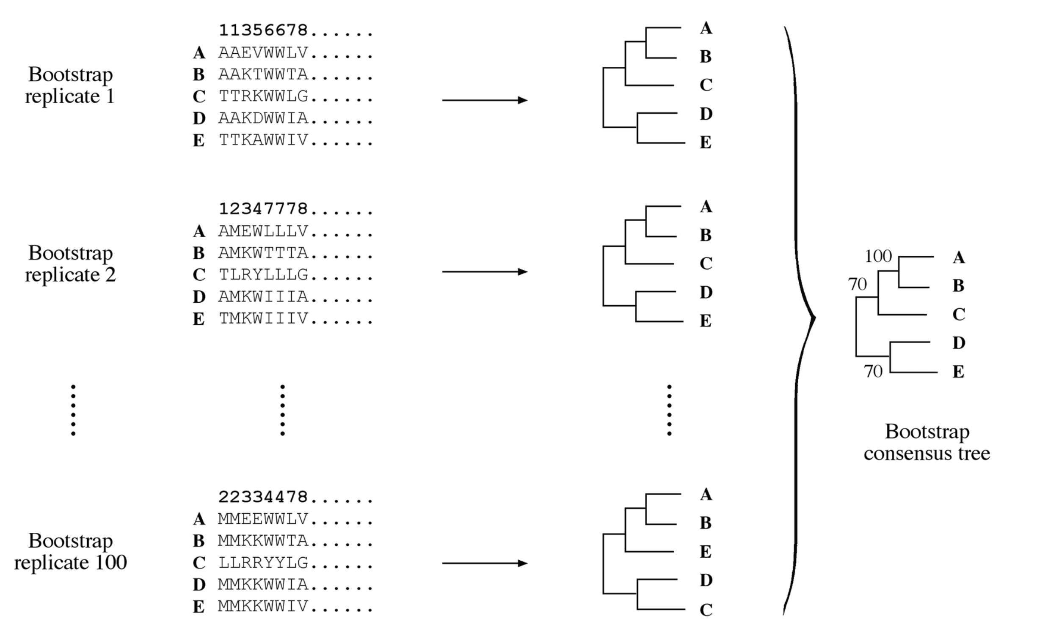
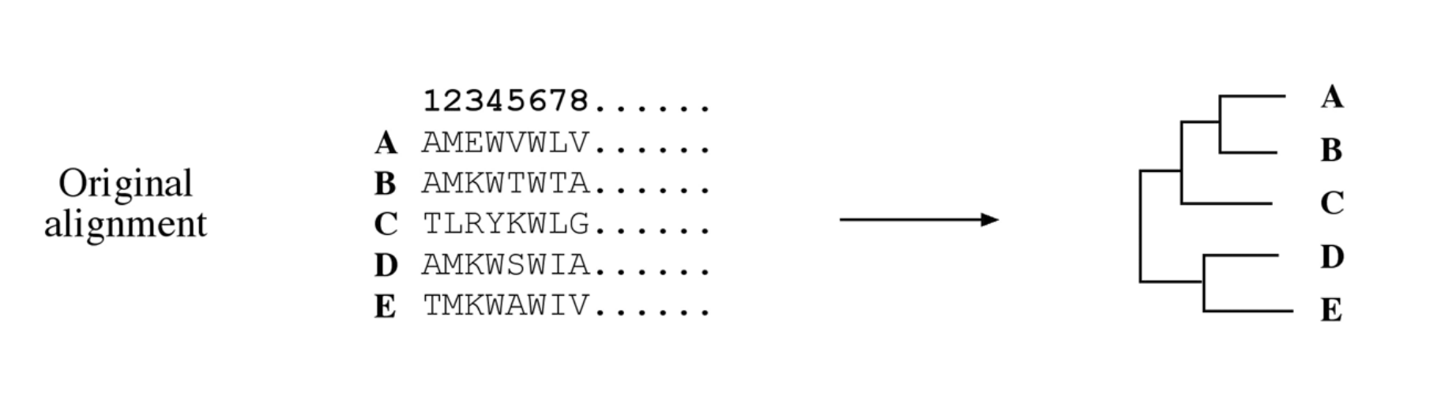
Phylogenetics
Phylogenetic tree evaluation : Bootstrapping
The original alignment and modified replicates in which certain sites are randomly replaced with other existing sites. The resulting altered replicates are used to building trees for statistical analysis at each node.

Slide 51
Phylogenetics
Phylogenetic tree evaluation : Jackknifing
In addition to bootstrapping, another often used resampling technique is jackknifing.
In jackknifing, one half of the sites in a dataset are randomly deleted, creating datasets half as long as the original.
Each new dataset is subjected to phylogenetic tree construction using the same method as the original.
The advantage of jackknifing is that sites are not duplicated relative to the original dataset and that computing time is much shortened because of shorter sequences.
One criticism of this approach is that the size of datasets has been changed into one half and that the datasets are no longer considered replicates.
Thus, the results may not be comparable with that from bootstrapping.

Slide 52
Applications of Phylogenetics analysis
Constructs evolutionary history of all life forms and identifies how and when new species emerged.
Updates taxonomic classification based on genetic data and discovers and classifies new species using DNA barcoding.
Identifies the source and transmission pathways of infectious diseases informing vaccine design understanding evolution of viruses.
Identifies genetic diversity and prioritize conservation efforts based on evolutionary distinctiveness.
Identifies beneficial traits that origins in wild relatives understanding the evolution of pests and pathogens affecting agriculture.
Studies human migration patterns and ancestral origins.
Analyzes DNA evidence to determine relationships between individuals.

Slide 53
Phylogenetic Tree Construction steps
1. Selection of molecular marker
The first step in constructing a phylogenetic tree is to choose the appropriate molecular marker.
The choice of molecular marker depends on the characteristics of the sequences and the purpose of the study. Either nucleotide or protein sequence data can be used.
For closely related organisms, nucleotide sequences are preferable, while for more divergent groups, slowly evolving nucleotide sequences or protein sequences may be used.
Protein sequences are preferred over nucleotide sequences in many cases because they are more conserved and allow for more sensitive alignment due to having more characters.
Although protein sequences offer several benefits for phylogenetic analysis, DNA sequences can also provide valuable information in certain instances, especially when dealing with closely related sequences.

Slide 54
Phylogenetic Tree Construction steps
2. Multiple sequence alignment
After the selection of molecular markers, the next step is to align the sequences from different species.
This is the most important step because the accuracy of the resulting phylogenetic tree depends on the quality of the alignment.
Alignment programs such as T-Coffee can be used.
Gblocks is one of the automatic programs that can help improve alignment by eliminating poorly aligned positions and divergent regions.

Slide 55
Phylogenetic Tree Construction steps
3. Selection of a model of evolution
The third step of phylogenetic tree construction is the selection of an appropriate evolutionary model.
Evolutionary (or substitution) models are statistical models that describe the substitution and divergence of sequences over time.
There are several substitution models available for both nucleotide and amino acids.
Two commonly used substitution models for nucleotides are the Jukes-Cantor (JC) model and Kimura’s two-parameter model.
There are also many amino acid substitution models. The most commonly used ones are the Dayhoff model (PAM) and the Jones-Taylor-Thornton (JTT) model.

Slide 56
Phylogenetic Tree Construction Steps
4. Construction of the phylogenetic tree
The next step is the construction of the phylogenetic tree.
The two main methods for constructing phylogenetic trees are distance-based and character-based methods.
Distance-based methods rely on computing the amount of dissimilarity between sequences, while character-based methods use molecular sequences from individual taxa to trace the character states of the common ancestor.

Slide 57
Phylogenetic Tree Construction Steps
5. Assessment of the reliability of the tree
The final step involves assessing the reliability of the phylogenetic tree. This can be done by a statistical method called bootstrapping which is used to assess the reliability of a phylogenetic tree’s topology.
It involves repeatedly resampling the initial sequence data to generate multiple subsets of derived sequences, referred to as bootstrap samples.
These samples are then used to construct a new phylogenetic tree using the same method as the original tree.
Interior branches that are accurately predicted by the new tree are assigned a value of 1. This process is repeated numerous times, and the percentage of times each interior branch receives a value of 1 is calculated as the bootstrap value or confidence value.
A bootstrap value of 95 or more is generally considered to indicate an accurate topology, and these values are expressed as percentages on the branches of the phylogenetic tree.
Besides bootstrapping, other resampling strategies like Jackknifing and Bayesian Simulation can also be used.

Slide 58
Thank you !!!

Slide 59
Phylogenetics
PHYLIP https://evolution.genetics.washington.edu/phylip.html
If an alignment is produced using CLUSTAL W or edited using GeneDoc, the alignment may be saved in PHYLIP format and then used in PHYLIP programs directly
Once the user activates a given PHYLIP program and loads the infile, the user can then choose from an option menu or accept the default values
The output is given to a file called outfile and treefile where applicable
If the output is to be read by another program, then the outfile must be renamed as before execution of the program since all files named outfile or treefile will be overwritten at the beginning of program execution
The tree file generated is a widely used format that can be imported into a variety of tree-drawing programs, including DRAWGRAM and DRAWTREE that come with this package
However, these PHYLIP tree-drawing programs produce low-resolution graphics, so a program such as TreeView is instead recommended

Slide 60
Phylogenetics
PHYLIP https://evolution.genetics.washington.edu/phylip.html
PHYLIP stands for Phylogeny Inference Package
It consists of about 30 programs that cover most aspect of phylogenetic analysis
It is a free program and available for wide variety of operating system platforms
The author of PHYLIP claims that it is the mostly used program currently
It is a command line program thus, no GUI.
The documentation is well written and very comprehensive, and the interface is straightforward
A program within PHYLIP is called on by typing its name which causes the data to be read from a file called infile
If no infile exists, you can specify the filename
The infile must be in PHYLIP format
This format is clearly described in the documentation, and most sequence analysis programs offer the ability to export sequences in this format

Slide 61
Phylogenetics
PAUP http://paup.phylosolutions.com/
The objective of the development of PAUP is to provide a phylogenetics program that includes as many functions (including tree graphics) as possible in a single, platform-independent program with a menu interface.
PAUP stands for Phylogenetic Analysis Using Parsimony and still contains one of the most sophisticated parsimony programs available.
Version 3 performed only MP-associated tree-building and analytical functions.
PAUP version 4 also includes distance and ML functions for nucleotide data and other new features
Current tree-building functions in PAUP include MP, and, for nucleotide data, distance and ML using the fastDNAml algorithm
Each tree-building program permits a variety of options
The MP options include specification of any character weighting scheme
Distance options include choice of NJ, ME, FM, and UPGMA procedures

